Slide 1
Advanced Encryption Standard
Chapter – 5
(AES)

Slide 2
Recall weakness of the DES
All of the cryptographic algorithms we have looked at so far have some problem.
The earlier ciphers can be broken with ease on modern computation systems.
The DES algorithm was broken in 1998 using a system that cost about $250,000.
It was also far too slow in software as it was developed for mid-1970’s hardware and does not produce efficient software code.
Triple DES on the other hand, has three times as many rounds as DES and is correspondingly slower.
What was required? A brand new encryption algorithm

Slide 3
Inner Workings of a Round
Step 1: State array construction and Key expansion
A single 128 bit block both for en/decryption is called in matrix
The in matrix block is grouped into 16 bytes and copied into a state array (4 x 4 matrix) which is modified at each stage of an algorithm & then copied to an output matrix.
Both the plaintext & the encryption key are depicted as 128 bit square matrix of bytes.
The encryption key is expanded into an array of key schedule words (the w matrix).
It must be noted that the ordering of bytes within the in matrix is by column. The same applies to the w-matrix.

Slide 4
Step 2: Add round key (making XOR)
The algorithm begins with an Add round key stage followed by 9 rounds of four stages and a tenth round of three stages.
The 128 bit block XORed with the encryption key
Step 3: Round operations
3.1. Substitute bytes
3.2. Shift rows
3.3. Mix Columns (not used in the last round, 10th round )
3.4. Add Round Key
Output --- Ciphertext

Slide 5
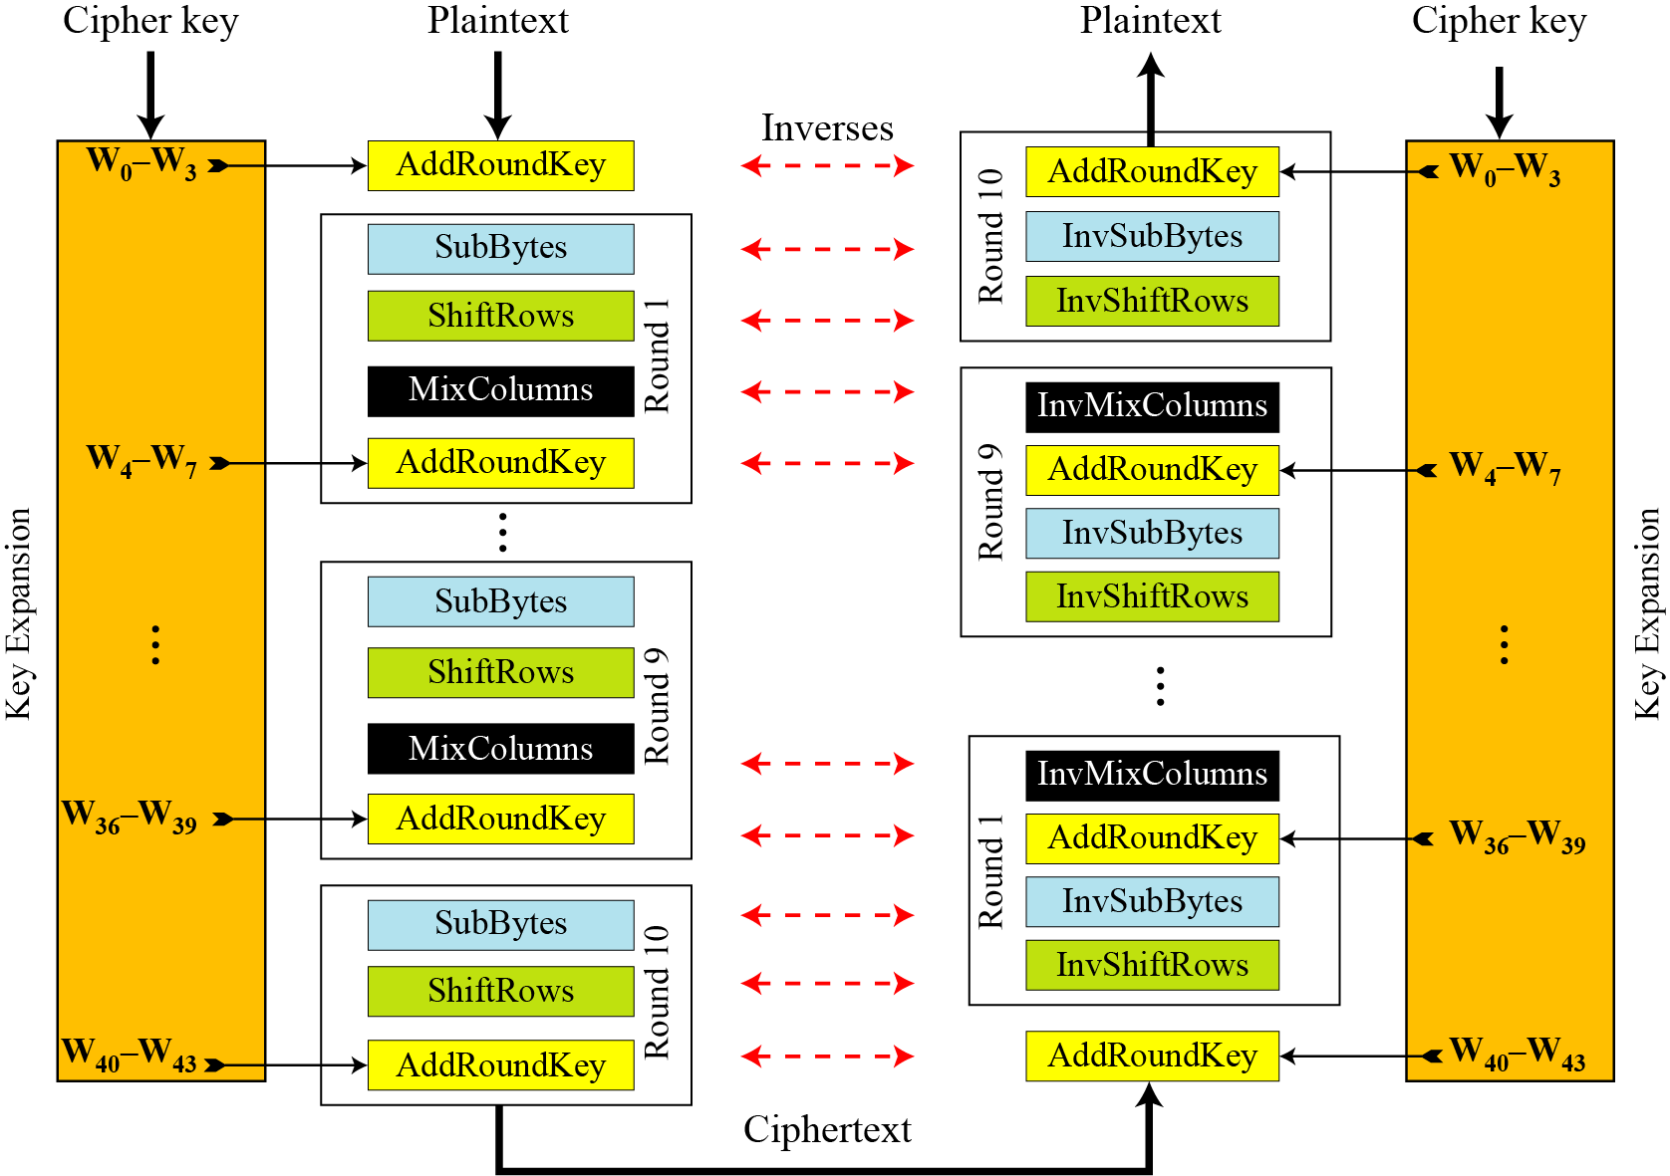

Slide 6
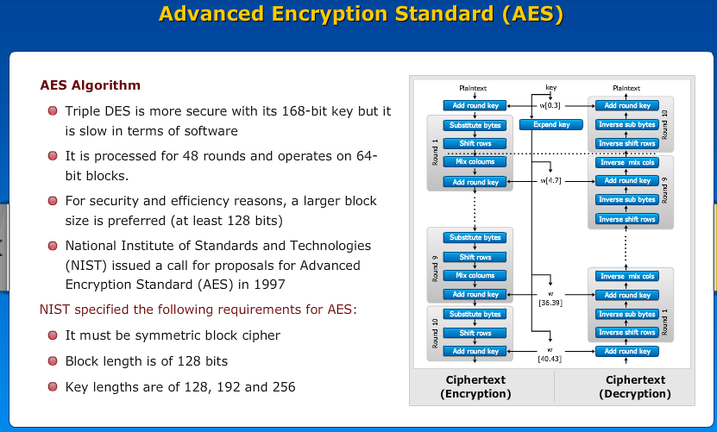

Slide 7
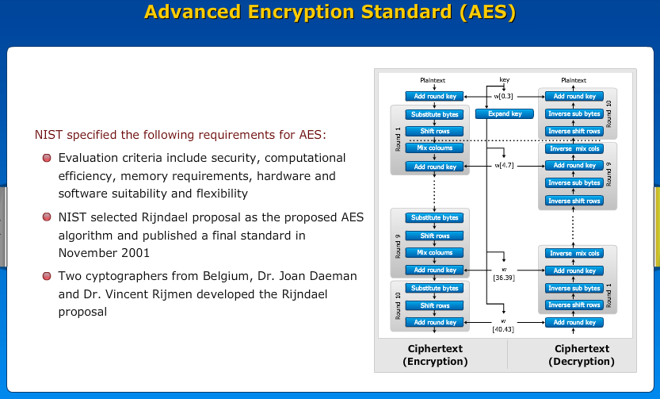

Slide 8
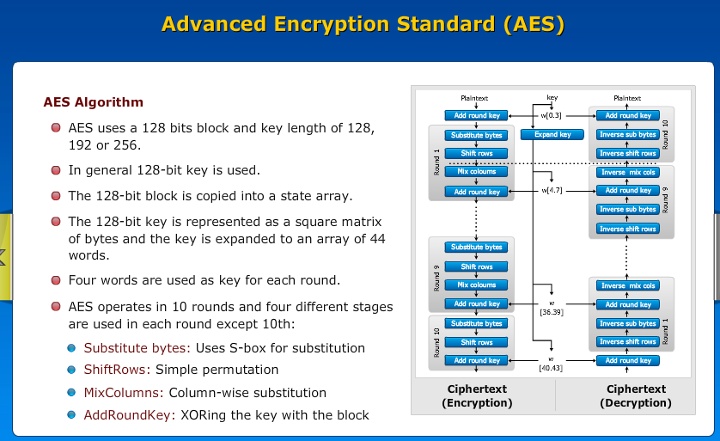

Slide 9
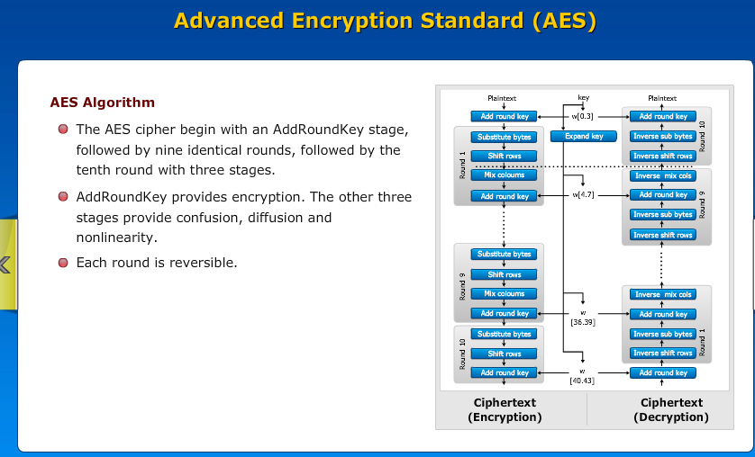

Slide 10
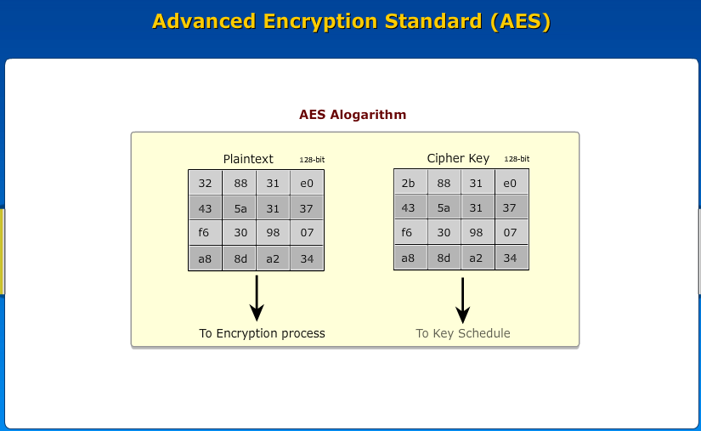

Slide 11
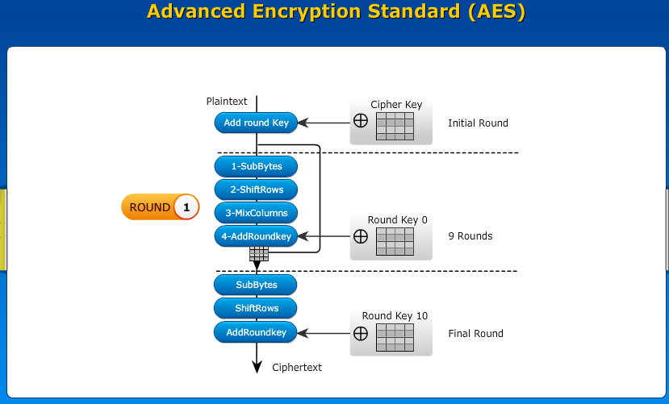

Slide 12


Slide 13
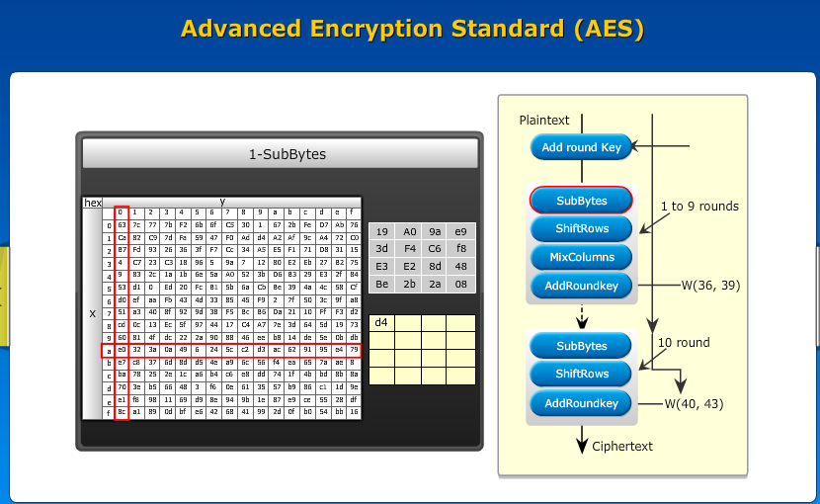

Slide 14
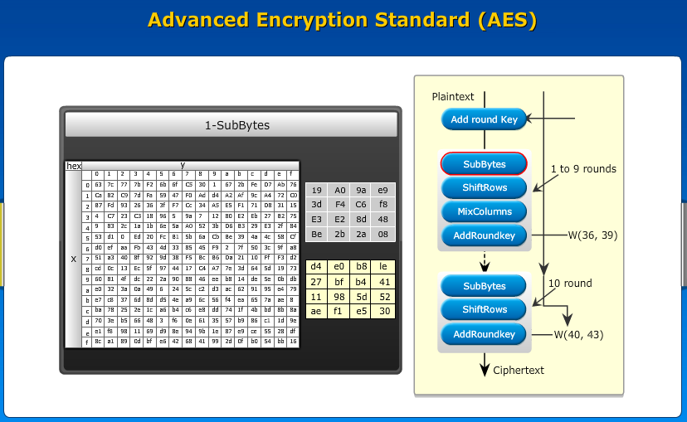

Slide 15
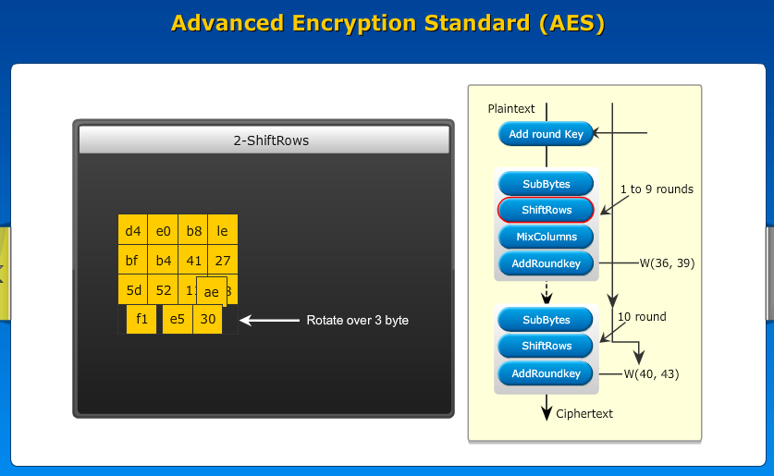

Slide 16
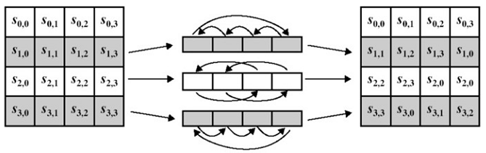
Shift Row Transformation
It is a simple permutation which works as follow:
The 2nd row is shifted 1 bytes to the left in a circular manner.
The 3rd row is shifted 2 bytes to the left in a circular manner.
The 4th row is shifted 3 bytes to the left in a circular manner.
The Inverse Shift Rows transformation (known as InvShiftRows) performs these circular shifts in the opposite direction for each of the last 3 rows (the first row was unaltered to begin with).

Slide 17
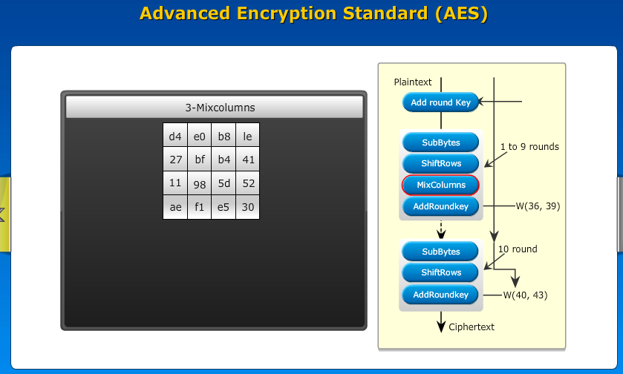

Slide 18
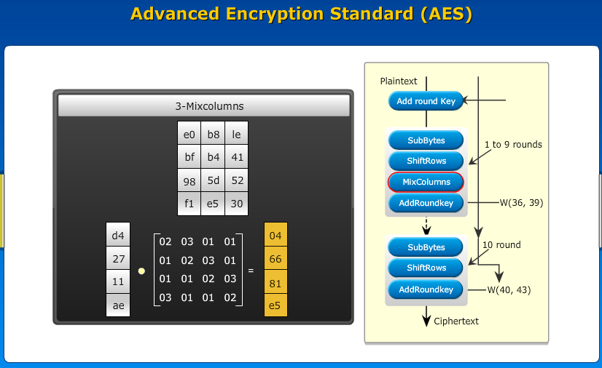

Slide 19
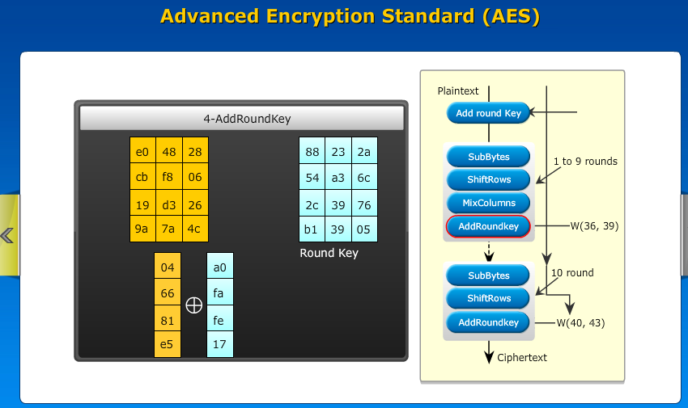

Slide 20
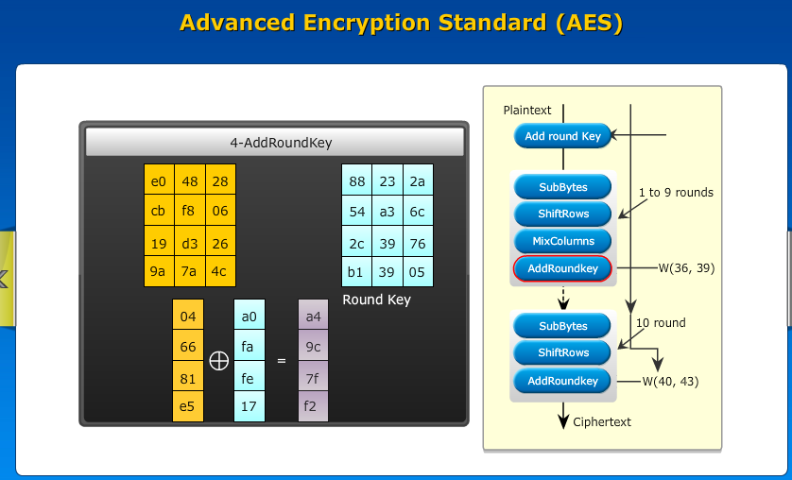

Slide 21
